Slide 1

COE322-Logic Design Lab
Final Project
LOGIC-CONTROLLED BOARD
NadiaAl Masri 202302750
Lara Bleik 20201445
Lynn Kaafarani 202308217

Slide 2
Overview
B
Sequence Detector
Counter
LED
functionality
for each
sequence
Capless
Hack
Using
555 timer

Slide 3
Introduction
This project revolves around building a logic-controlled board. In our approach, we first checked SW2 to determine the next state which is the sequence detector or locking state. The seqyence detector is a sequencial circuit reated to a combinational circuit (counter and leds)

Slide 4
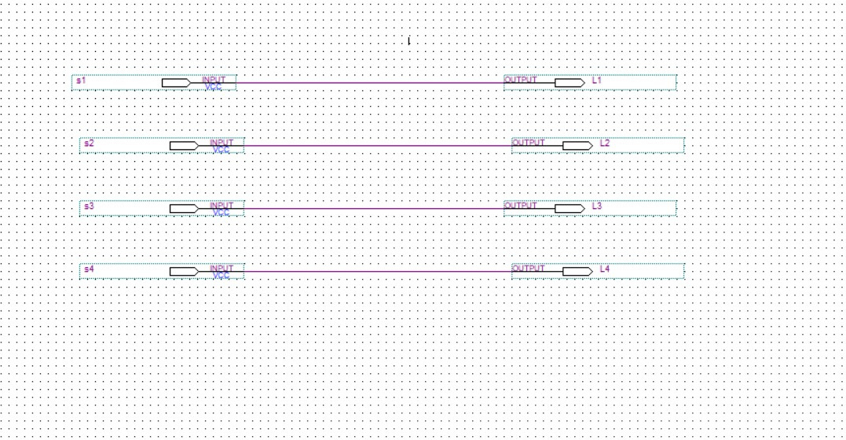
1:1 Mapping

Slide 5
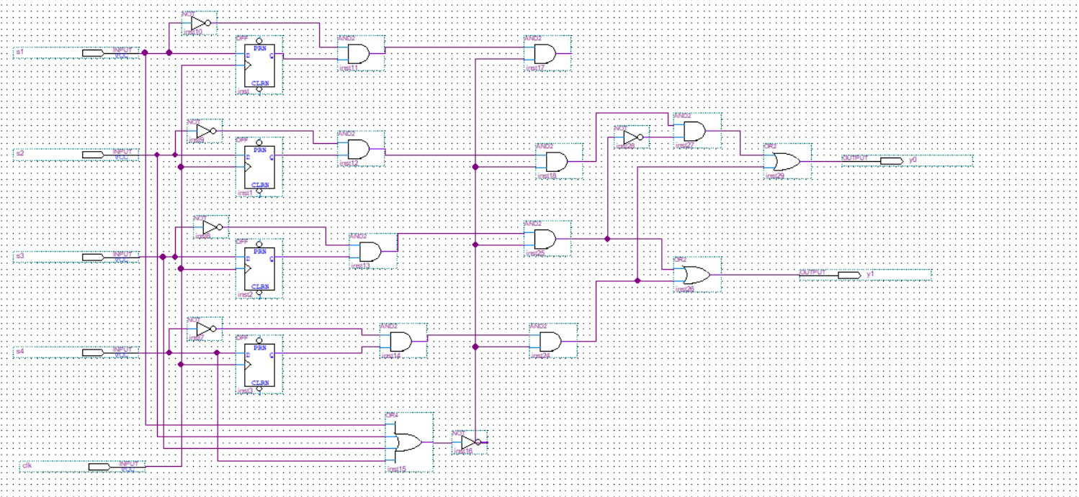
Sequence Detector

Slide 6
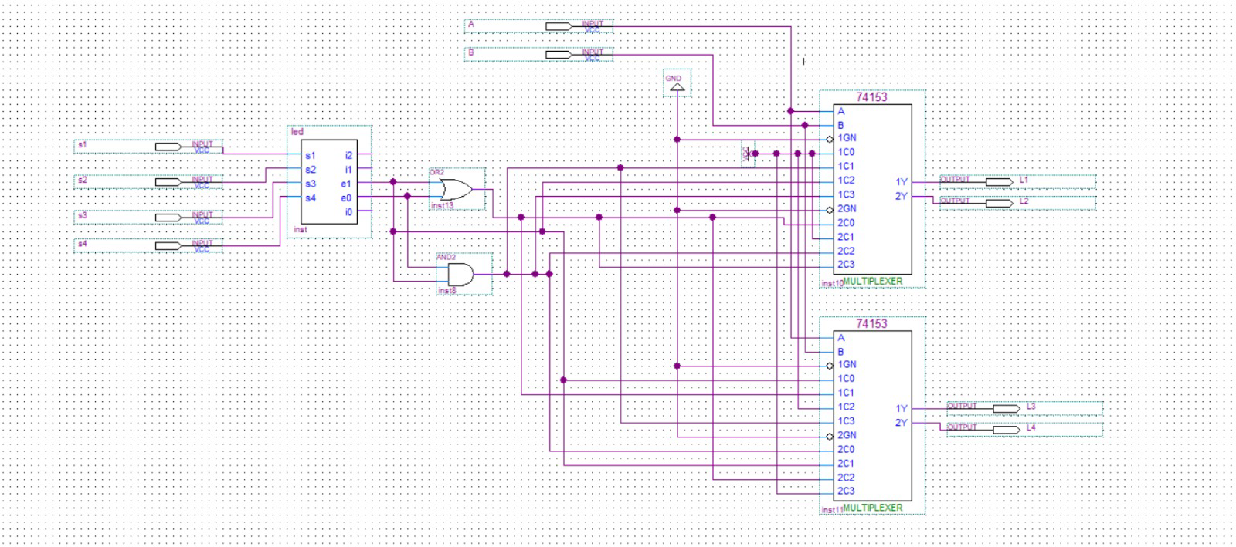
LEDs and Sequence

Slide 7
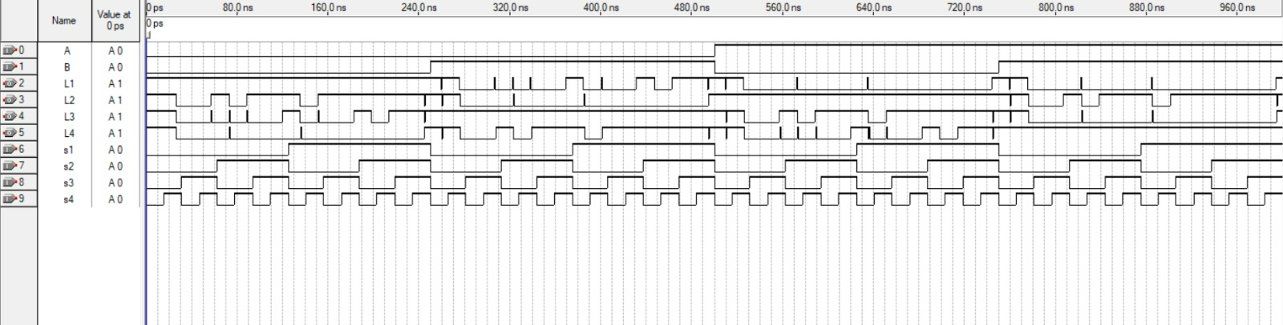
Output of the Simulation

Slide 8
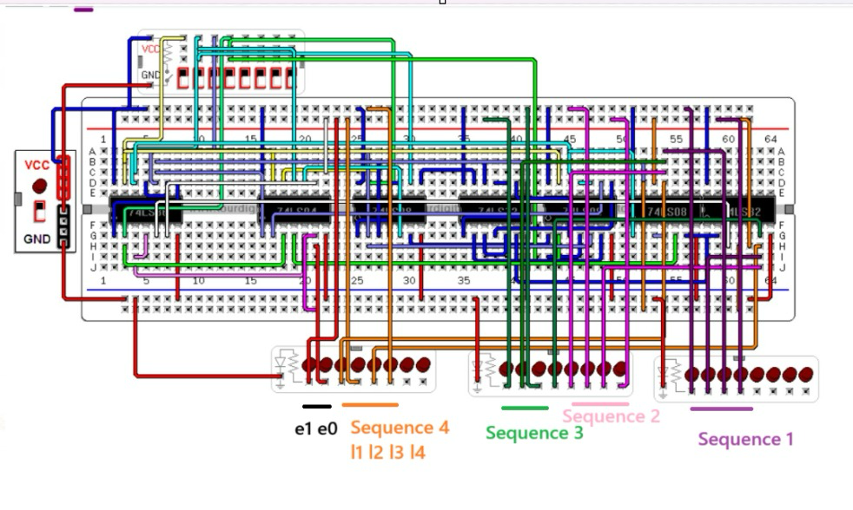
LEDs and Sequence on Circuitos

Slide 9
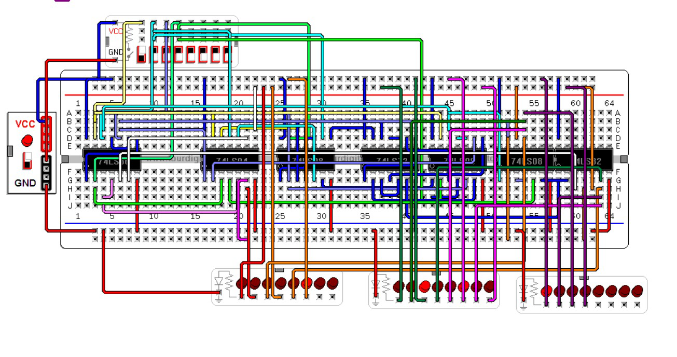
Case of E1E0=00

Slide 10
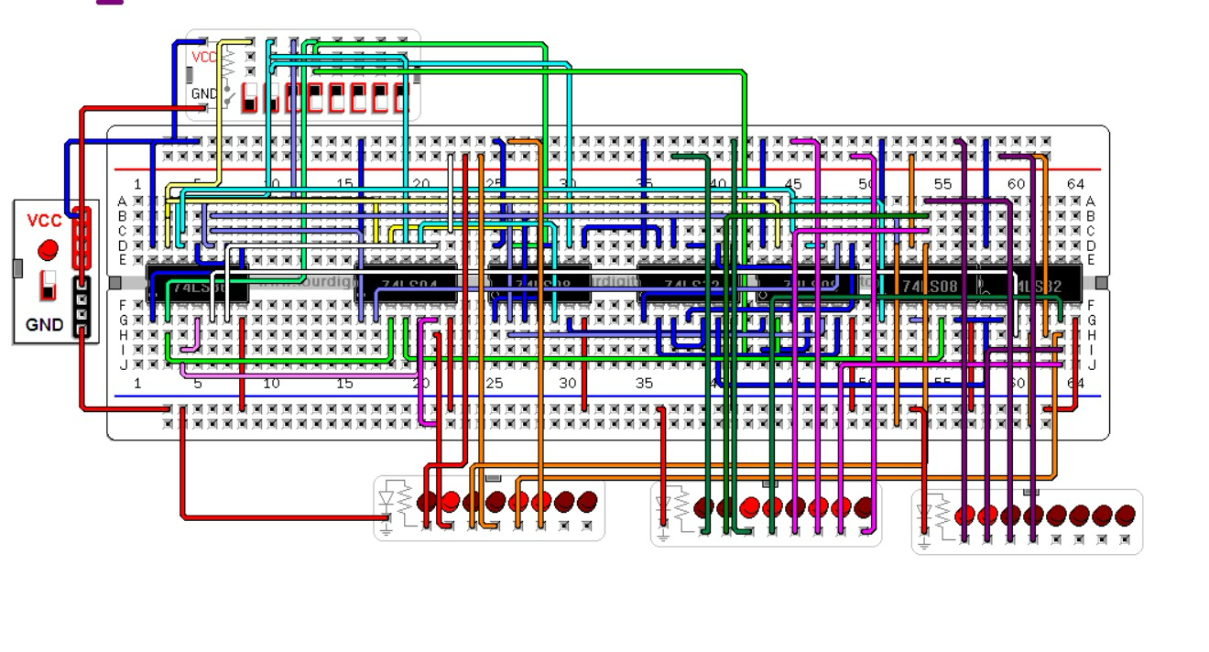
Case of E1E0=01

Slide 11
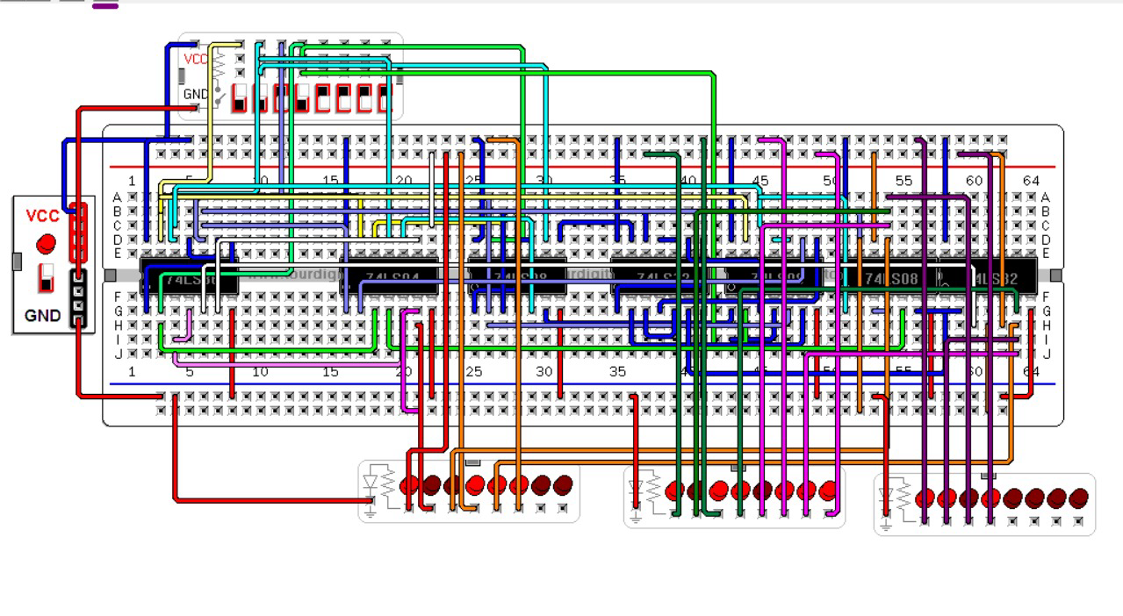
Case of E1E0=01

Slide 12
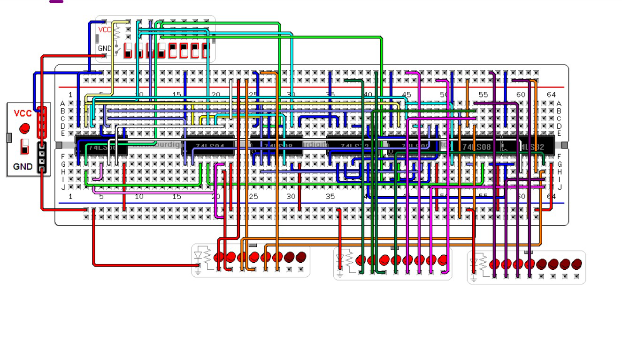
Case of E1E0=11

Slide 13
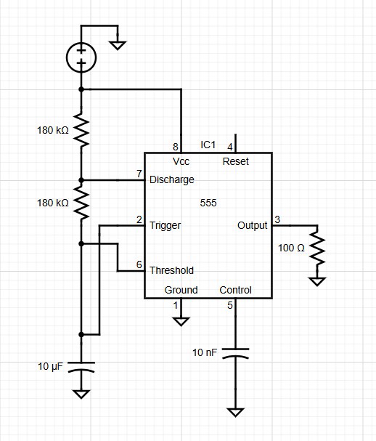
555 Timer in astable Mode

Slide 14
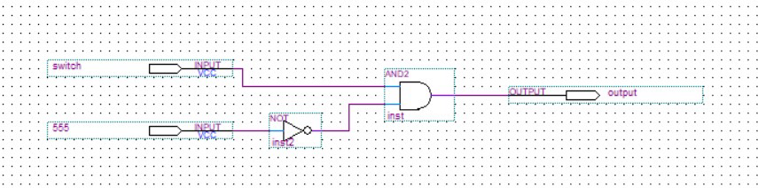
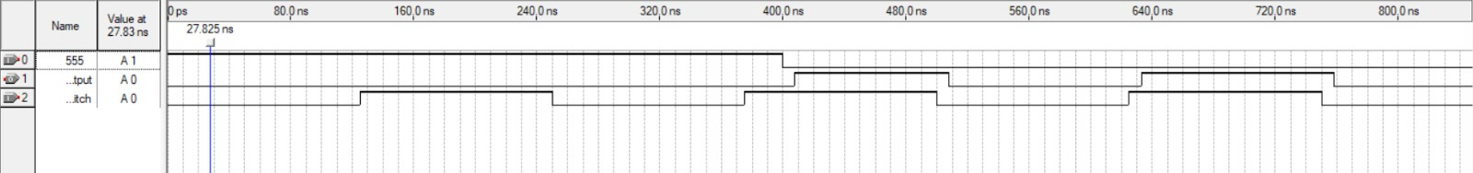
The Capless Hack

Slide 15
THANK YOU!

